Slide 1
Address Book
Developed By Joeseph Sande

Slide 2
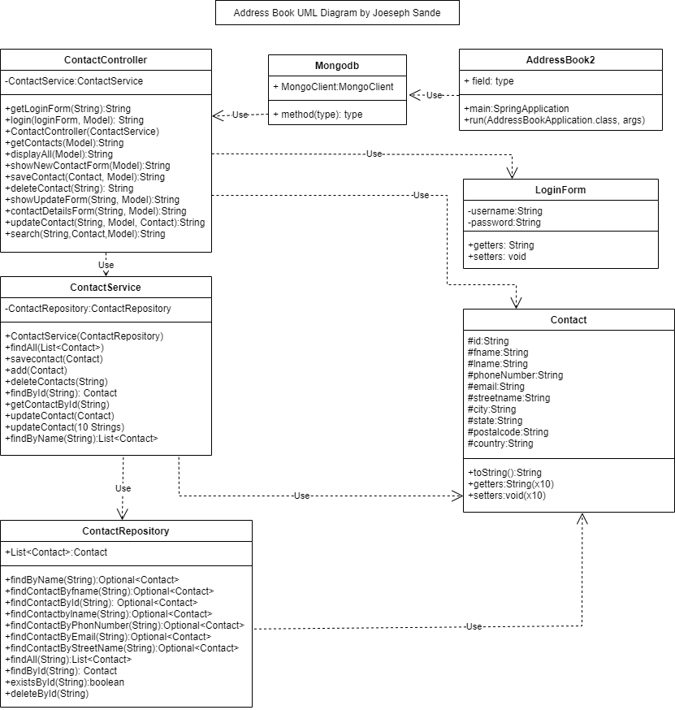
UML Diagram

Slide 3
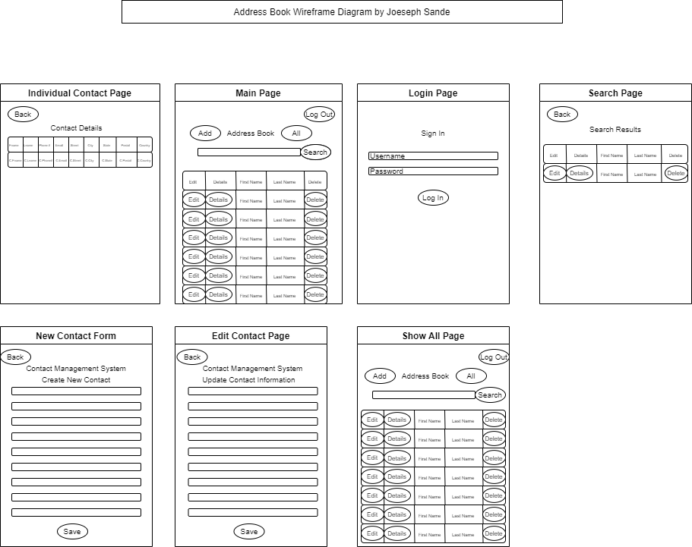
Wireframe Diagram

Slide 4
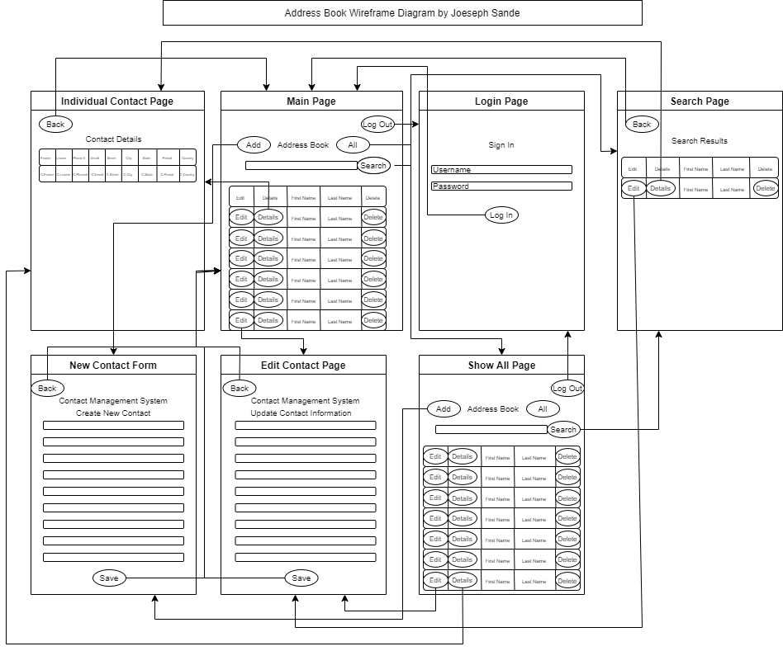
Wireframe diagram With navigation

Slide 5
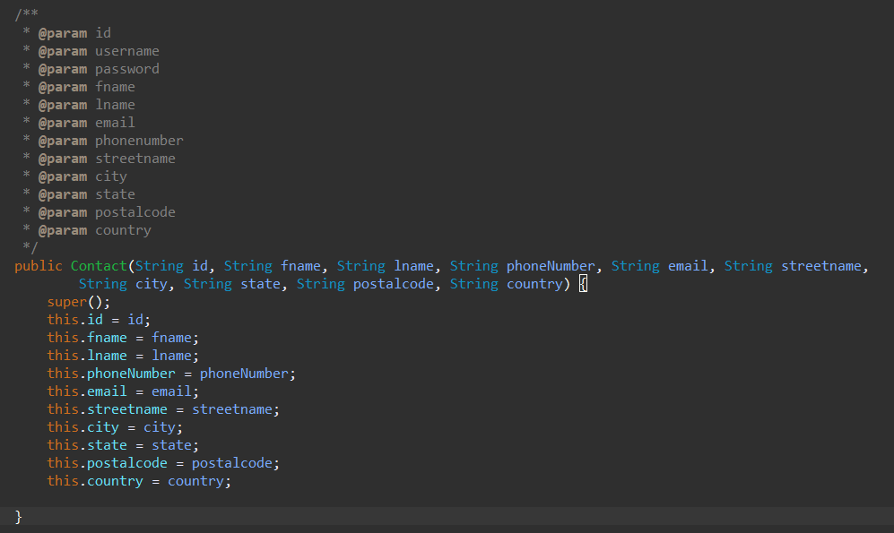
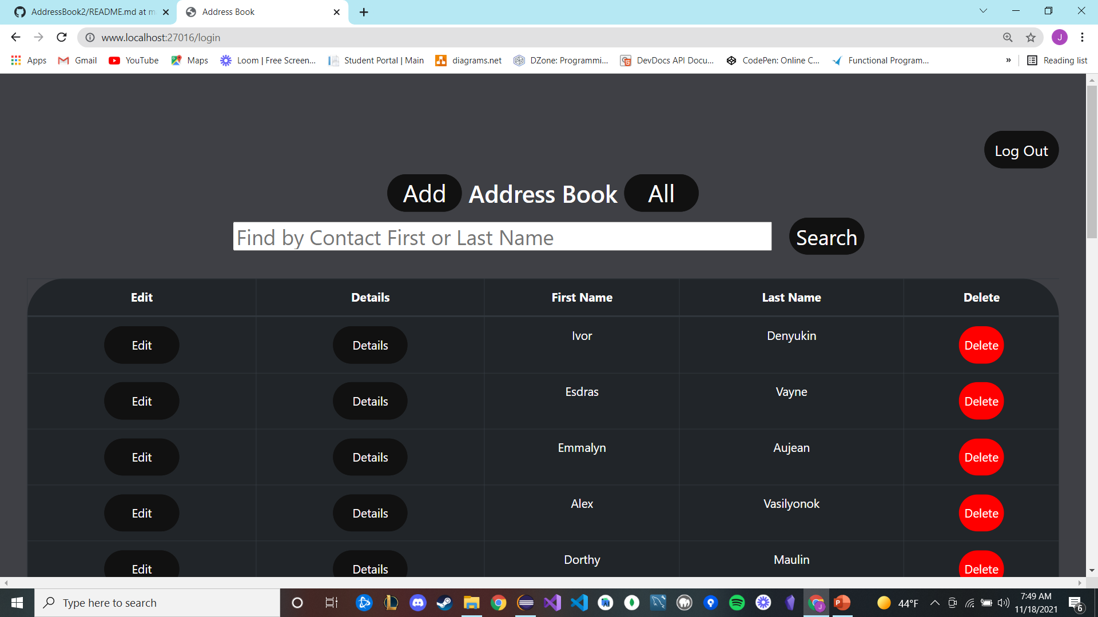
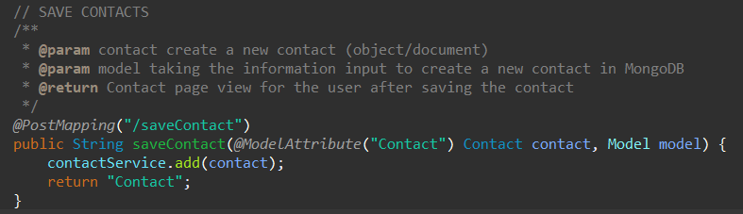
Model View Controllers
Model View Controllers are what applications are built from.
Models are the object classes being utilized in the application.
Views are the html forms for the user to view.
Controllers are the logic behind the manipulation of the data within the program for the model and forms.

Slide 6
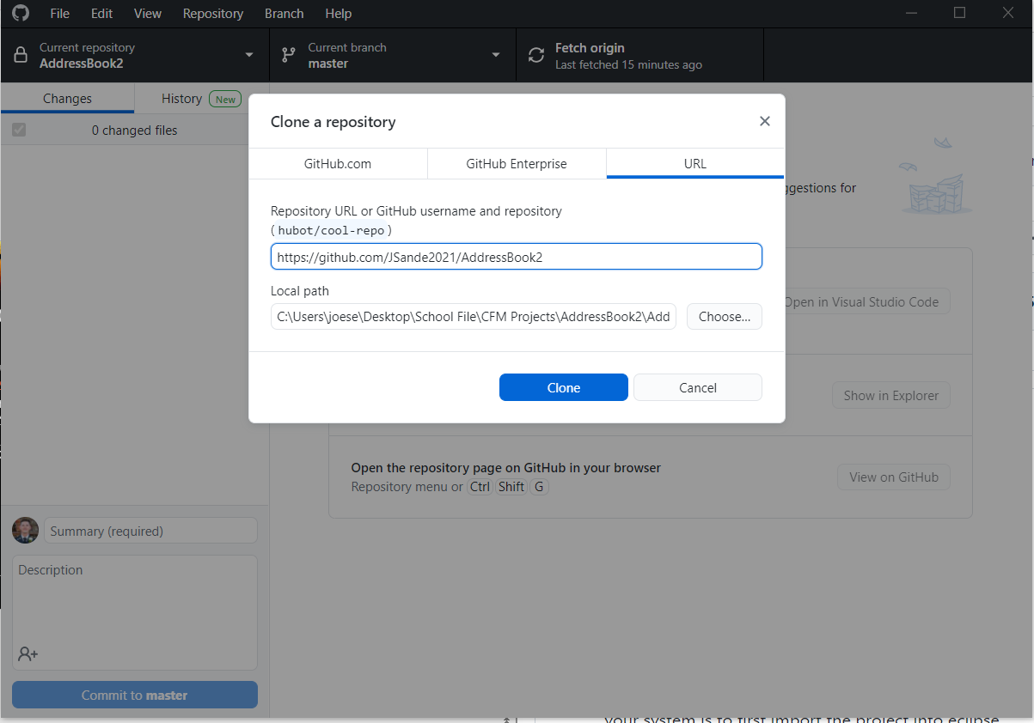
Clone the repository from github
Access my GitHub from the following link if I granted you access: https://github.com/JSande2021/AddressBook2
It’s easier to clone repository from GitHub Desktop Application and add it into your IDE from the location that GitHub has configured.

Slide 7



Starting the Application
Requires an IDE such as Eclipse to be installed on your computer.
Open the project file from where it was stored during the cloning from GitHub
Once open, navigate through the src/main/java file until you reach the AddressBookApplication.java file.
Open this file and click the green arrow at the top of the IDE to start the application.

Slide 8
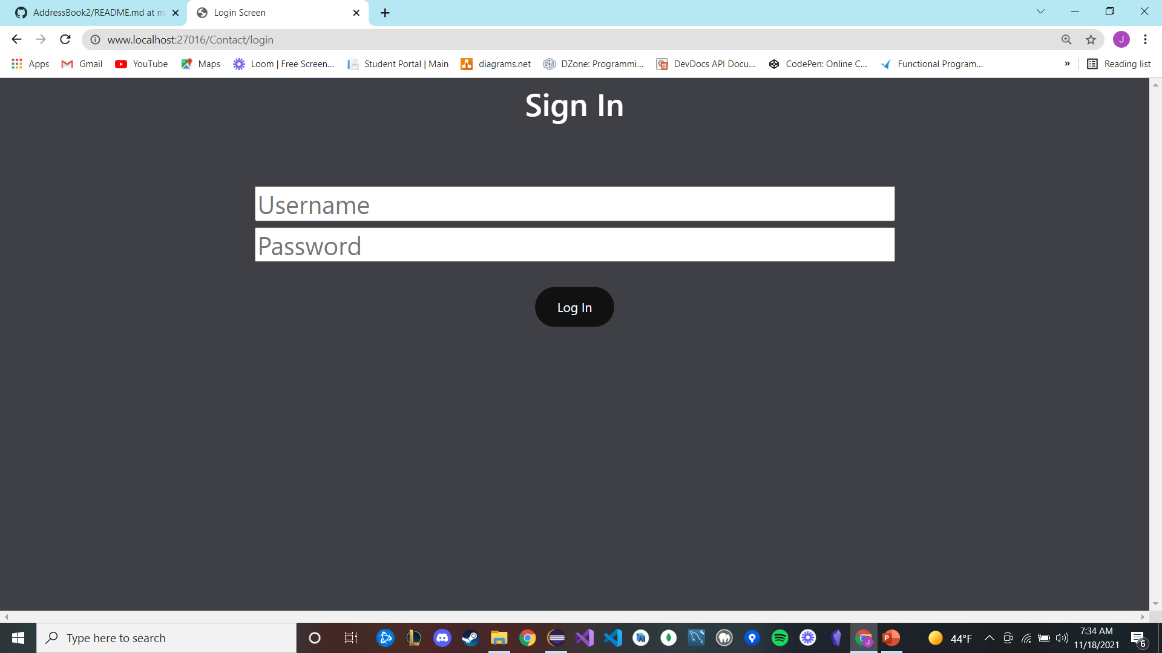
Opening the Application
Open up a new web browser of your choice.
Copy and paste the following link into the browser: http://www.localhost:27016/Contact/login

Slide 9
Log In To The Application
Enter the given username: admin and password: admin.
Click the login button.

Slide 10
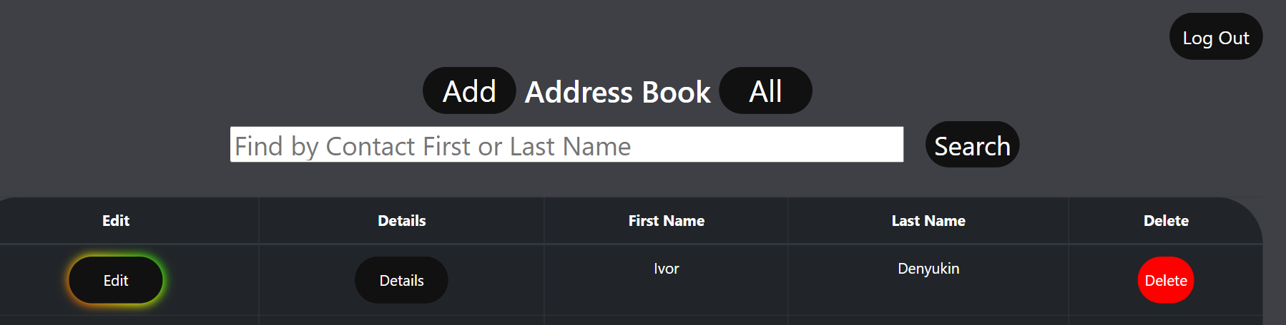
Utilizing the features
This application supports the CRUD functions of creating a contact, reading individual contacts, updating contacts, and deleting contacts.
Searching for either first or last names through the contacts is also supported.
Logging into and out of the application with a provided username and password.

